Slide 1

HANNA COSMECEUTICALS
Business Development
Simulation Programme
DAY 1
Onboarding, Ecosystem & the Business Model Canvas
4:00 PM – 8:00 PM · 20-minute break 5:25–5:45 PM
USD 10,000,000 Investment Programme · AI Co-Pilots: Claude · ChatGPT · Gemini

Slide 2
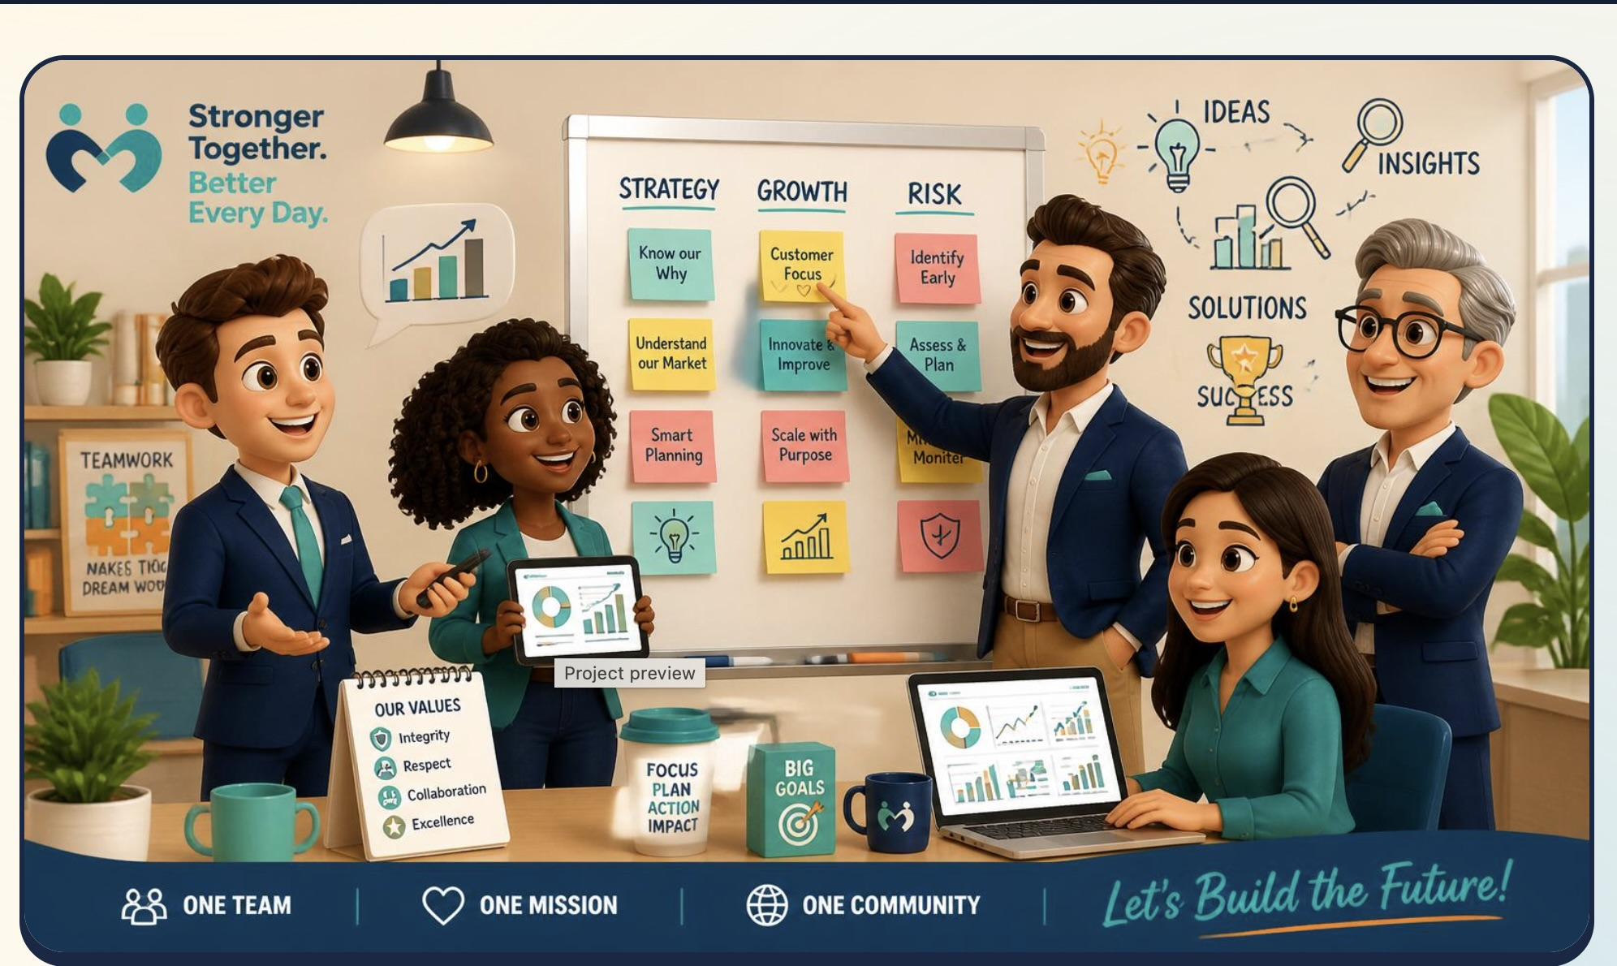



OUR VISION
Stronger together, better every day.
(Customer centricity)
One team. One mission. One community.

Slide 3
Expected Outcomes & Prerequisites
What participants will gain by the end of Day 1 — and what they need coming in.
Expected Outcomes
Knowledge — working command of BD frameworks and the structure of the Egyptian market.
Skills — conduct market research, map the business ecosystem, build a Business Model Canvas, sharpen market understanding, and read a P&L statement.
Attitude — adopt a proactive, resilient hunting mindset, and learn to understand and absorb Egyptian culture — local business etiquette, relationship-building norms and buyer behaviour.
Market language — acquire the local Egyptian-market vocabulary — deal terms, buyer objections and cultural cues — through role-plays in real scenarios.
Individual plan — each trainee leaves with a customized development plan mapped to personal gaps and strengths.
Prerequisites
Prior BD / sales experience or completion of earlier program levels.
Working familiarity with the product and service portfolio.
A laptop and a full-day commitment to active participation.

Slide 4
The BD Role in a Business Launch
Core responsibilities, distilled from BD job posts at Amazon and other leading companies.
Market & Opportunity Scan
Research the market, size the opportunity and target the high-value segments to enter.
Go-to-Market Strategy
Define the go-to-market approach and account plan for each industry segment.
Partnerships & Alliances
Build and manage the strategic partnerships that speed up market entry.
HR & Operations
Coordinate hiring, team setup and day-to-day operations to support the launch.
Pipeline & New Business
Own lead generation, new-customer acquisition and the full sales pipeline.
Deal-Making & Negotiation
Build the business case, negotiate terms and close strategic deals.
Voice of Customer
Relay market feedback to product and align cross-functional teams.
Legal & Regulatory
Track and follow up legal and compliance issues specific to the Egyptian market.

Slide 5
The Learning Pyramid
Average retention rates — from passive methods at the top to active methods at the base.
5%
Lecture
Auditory
10%
Reading
20%
Audio-visual
Visual
30%
Demonstration
50%
Discussion
Kinesthetic
75%
Practice doing
90%
Teach others
Adapted from the NTL Institute of Applied Behavioral Science Learning Pyramid

Slide 6
From Data to Wisdom: The DIKW Pyramid
The goal isn’t more data—it’s better judgment at each step up.
Increasing context & value
Wisdom
What now?
Data → Information: Organize and analyze raw numbers until they begin to tell a story.
Information → Knowledge: Surface the patterns, relationships, and trends that turn information into a basis for decisions.
Knowledge → Wisdom: Apply knowledge with experience and judgment—asking the right questions and acting to drive real change.
Knowledge
How & why?
Information
Who · where · when?
Data
What?

Slide 7
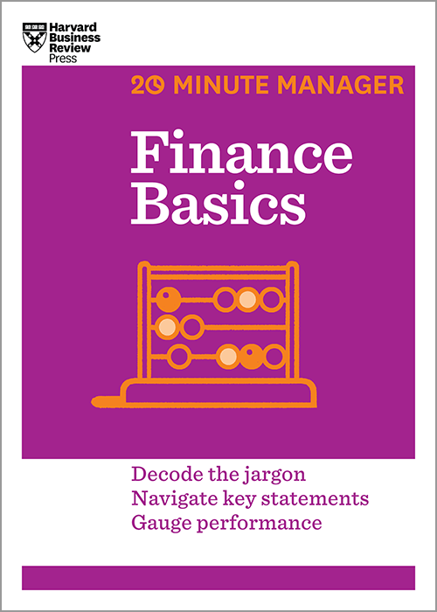

TOOLKIT · DAY 1
Recommended Reading
How Business Works
A visual guide to how a company’s functions connect.
Finance Basics
HBR 20-Minute Manager — read key statements, gauge performance.

Slide 8







Tools Required
The digital toolkit used throughout the BD simulation.
ChatGPT
Claude
Gemini
Lovable
Reverso
Excel
Outlook
PowerPoint
Reverso

Slide 9
Business Definition
In the Harvard Business Review, business means far more than making money—it’s a strategic story of how a company operates and makes a positive impact.
Value for customers
Delivers products and services people gladly pay for.
Solves problems
Addresses real needs and pain points in the market.
Adapts to change
Evolves its model as conditions and demands shift.

Slide 10
Business Development, Defined
According to McKinsey & Company, business development is a relentless — continues without stopping — structured pursuit of sustainable, inclusive, and profitable growth.
More than sales or partnerships, McKinsey calls it an organizational imperative (something absolutely necessary) — the “oxygen” of the company — connecting three disciplines to create long-term value:
Strategy
Sets the direction and priorities for growth.
Innovation
Creates new value and adapts to the market.
Execution
Turns plans into lasting, compounding results.

Slide 11
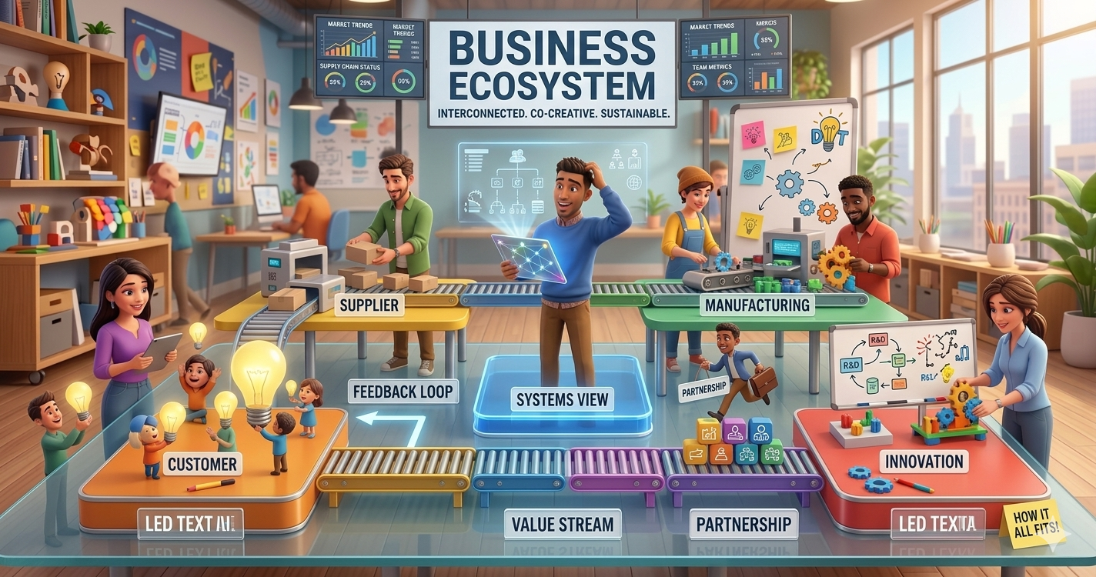
Ecosystem Definition
Understanding the business ecosystem
A business ecosystem is a dynamic, interconnected network of organizations — suppliers, distributors, competitors and customers — that collaborate and compete to deliver a valuable product or service.
Like a biological ecosystem, members co-evolve and rely on each other's success to drive innovation, share value and adapt to market changes.

Slide 12







DAY 1 · SESSION MAP
4:00 – 8:00 PM
Today at a Glance
4:00 – 4:15 PM
4:15 – 5:25 PM
5:25 – 5:45 PM
Kickoff & CEO Brief
Core Content
Rest Break
The CEO opens Day 1 in role: your mandate, the situation, and today's business question.
Hanna deep-dive, the Egyptian cosmeceutical ecosystem, and the Business Model Canvas — the 9 blocks.
20 minutes. Step away — you will need the energy for the build.
5:45 – 6:45 PM
6:45 – 7:35 PM
7:35 – 8:00 PM
Applied Workshop
AI Co-Pilot Lab
Deliverable & Debrief
In BD Squads: draft Version 1 of Hanna's Business Model Canvas for Egypt.
Research the ecosystem with ChatGPT / Gemini, then stress-test your BMC with Claude.
Submit BMC v1 — one page, all 9 blocks — and debrief with your coach.
HANNA COSMECEUTICALS · BD SIMULATION · DAY 1
02

Slide 13
4:00 PM · READ ALOUD, IN ROLE
The CEO Brief
“
Welcome aboard. You already know what happened with Vai Natural — I don't need you to fix that contract, legal is on it. What I need from you is a plan for a business that's actually ours, built from Saudi and Egyptian market outward. We've put ten million dollars behind this. Show me the shape of this business by end of day.
Founder & CEO, Hanna Cosmeceuticals
Today's business question: what is the shape of Hanna's Egypt / Saudi business?
HANNA COSMECEUTICALS · BD SIMULATION · DAY 1
03

Slide 14


CORE CONTENT · COMPANY DEEP-DIVE
4:15 – 5:25 PM
Hanna at a Glance
2023
3
100%
0
Operating in Saudi Arabia since
Hero products, natural & skin-first
Of revenue via one agency deal
Direct presence in Egypt — until now
The portfolio — deliberately small, deliberately focused
Sugar Scrub
Shea Body Butter
Underarm Detox Scrub
Exfoliating body scrub — the entry point into the brand.
Rich, moisturizing body butter — the repeat-purchase anchor.
Targeted brightening / detox treatment — the differentiator.
The catch: Hanna has never owned its commercial engine. Its entire Saudi presence was built as the exclusive agent for Vai Natural — a Jordanian brand — sourcing, registering, and distributing someone else's products. Egypt has always been the natural next chapter. It is still unexplored territory.
HANNA COSMECEUTICALS · BD SIMULATION · DAY 1
05

Slide 15
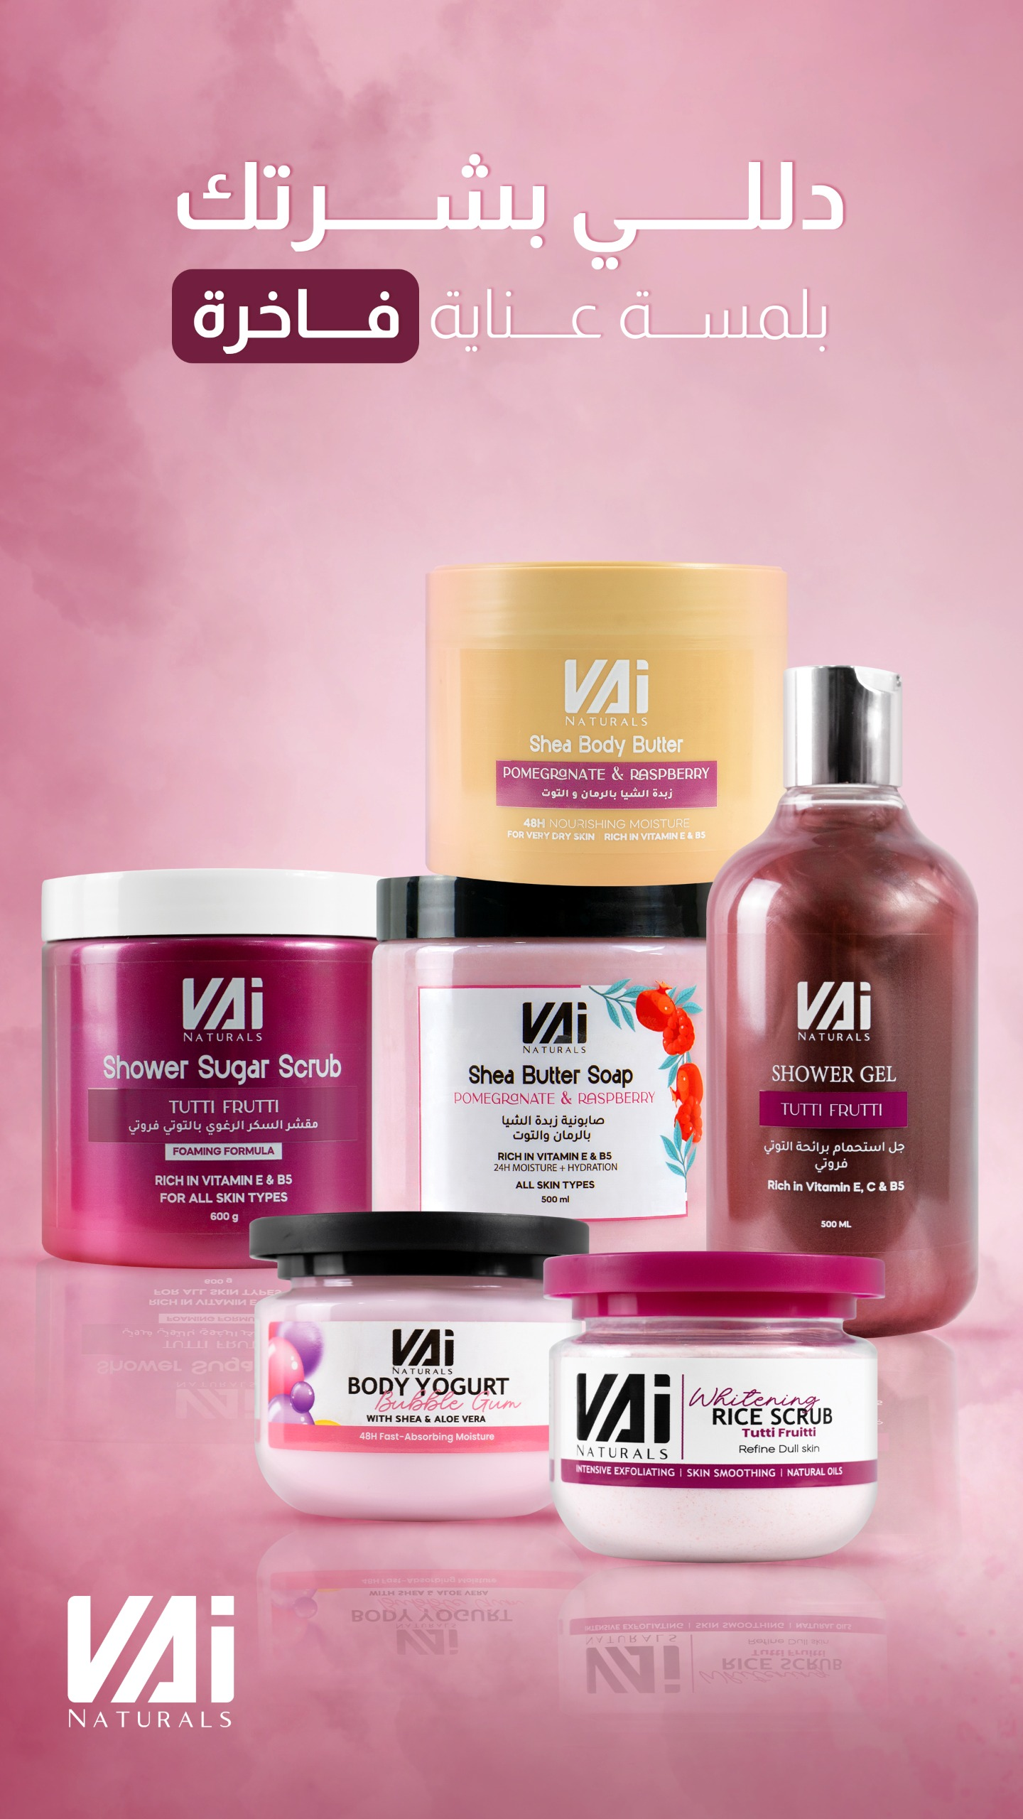
MARKET SPOTLIGHT
VAi Naturals
Pamper your skin with a luxurious touch of care.
Shea body butter & butter soap
Sugar & rice body scrubs
Shower gel & body yogurt
Vitamin-enriched — for all skin types

Slide 16




CORE CONTENT · THE TRIGGER EVENT
4:15 – 5:25 PM
Vai Natural Pulls the Plug
3 WEEKS AGO
IN ~60 DAYS
SUSPECTED
Written termination notice
Revenue line disappears
A direct regional office
Vai Natural terminates the agency agreement — no commercial, legal, or performance justification given.
Hanna's only commercial engine — its entire Saudi presence — shuts down when the notice takes effect.
Leadership suspects Vai Natural is going direct in the region. Unconfirmed. Legal is reviewing recourse — in parallel.
What this means for your role
Not your problem: the contract dispute. Legal counsel owns that track — it runs in parallel.
Your problem: Hanna cannot rebuild on a single external partner, and cannot remain a single-market business.
The founders call this a forcing function, not just a crisis — the push to build a business that is Hanna's, end-to-end.
HANNA COSMECEUTICALS · BD SIMULATION · DAY 1
06

Slide 17



DAY 1 · WHY TODAY MATTERS
What You Will Walk Out With
Know the business cold
WHERE DAY 1 SITS
Hanna's history in Saudi Arabia, its three hero products, the Vai Natural agency model — and why it collapsed.
1
Ecosystem & BMC
Industry Life Cycle
Read the ecosystem
2
Market Sizing & STP
Map the players around Hanna in Egypt: manufacturers, competitors, channels, regulators, retail & e-commerce, customers.
3
Journey & 4Ps
4
Sales Plan & CRM
Master the Business Model Canvas
Learn the 9 blocks and use them to structure the private-label launch, Egypt entry, and regional HQ — on one page.
5
Partnerships & Deals
6
Breakeven & P&L
Produce a real deliverable
Leave tonight with BMC v1: your first board-facing artifact, and the foundation of your Day 7 business plan.
7
Final Plan & Pitch
HANNA COSMECEUTICALS · BD SIMULATION · DAY 1
04

Slide 18



CORE CONTENT · THE MANDATE
4:15 – 5:25 PM
Your Role: Three Parallel Workstreams
A
B
C
Private Label & Product Innovation
Egypt Market Entry
Regional Headquarters Build
Develop Hanna's own version of the three product categories — real formulation, positioning, and packaging innovation, not a copy of the old products.
Build Hanna's first-ever go-to-market plan for its home market: research, segmentation, channels, pricing, sales pipeline, and partnerships — from zero.
Stand up Cairo as Hanna's Regional HQ for North Africa & Africa — the base from which every future African market entry is planned, funded, and run.
Convergence point: all three workstreams feed one deliverable — a single, numbers-backed business plan (with capital deployment) the founders can approve and fund on Day 7.
HANNA COSMECEUTICALS · BD SIMULATION · DAY 1
07

Slide 19


CORE CONTENT · THE CAPITAL BEHIND THE MANDATE
This Is Not a Hypothetical Number
USD 10,000,000
Committed by Hanna's founders and investors — specifically for the Egypt entry and the North Africa/Africa regional HQ. Every plan this week must show how it is deployed, over what horizon, and survive the breakeven and P&L work later in the programme.
INDICATIVE CAPITAL CATEGORIES (NON-BINDING)
Product development
Regional HQ setup
Egypt go-to-market
Working capital
Expansion reserve
Private-label formulation & innovation
Office, regulatory, warehousing (Cairo)
Sales, marketing, channel launch
Inventory & runway to breakeven
First NAA market beyond Egypt
HANNA COSMECEUTICALS · BD SIMULATION · DAY 1
08

Slide 20





CORE CONTENT · FRAMEWORK 1
4:15 – 5:25 PM
Mapping the Egyptian Ecosystem
Before you can design a business model, you must see the board. An ecosystem map names every player that can help, block, or compete with Hanna in Egypt — plus the wider North Africa/Africa landscape Cairo will serve as HQ.
Suppliers & Manufacturers
Competitors
Distribution Channels
Private-label formulation and packaging partners — the make-or-buy backbone.
Local and regional natural body-care and cosmeceutical brands already on shelf.
Distributors, wholesalers, and the routes products physically travel.
Regulators
Retail & E-commerce
The Customer
Egyptian Drug Authority — cosmetics registration basics before anything sells.
Pharmacies, concept stores, marketplaces — where the customer actually buys.
Egyptian consumers of natural, skin-first personal care — the center of the map.
Facilitator note: close this section with a first look at the wider North Africa / Africa landscape — the markets Cairo would eventually serve.
HANNA COSMECEUTICALS · BD SIMULATION · DAY 1
09

Slide 21
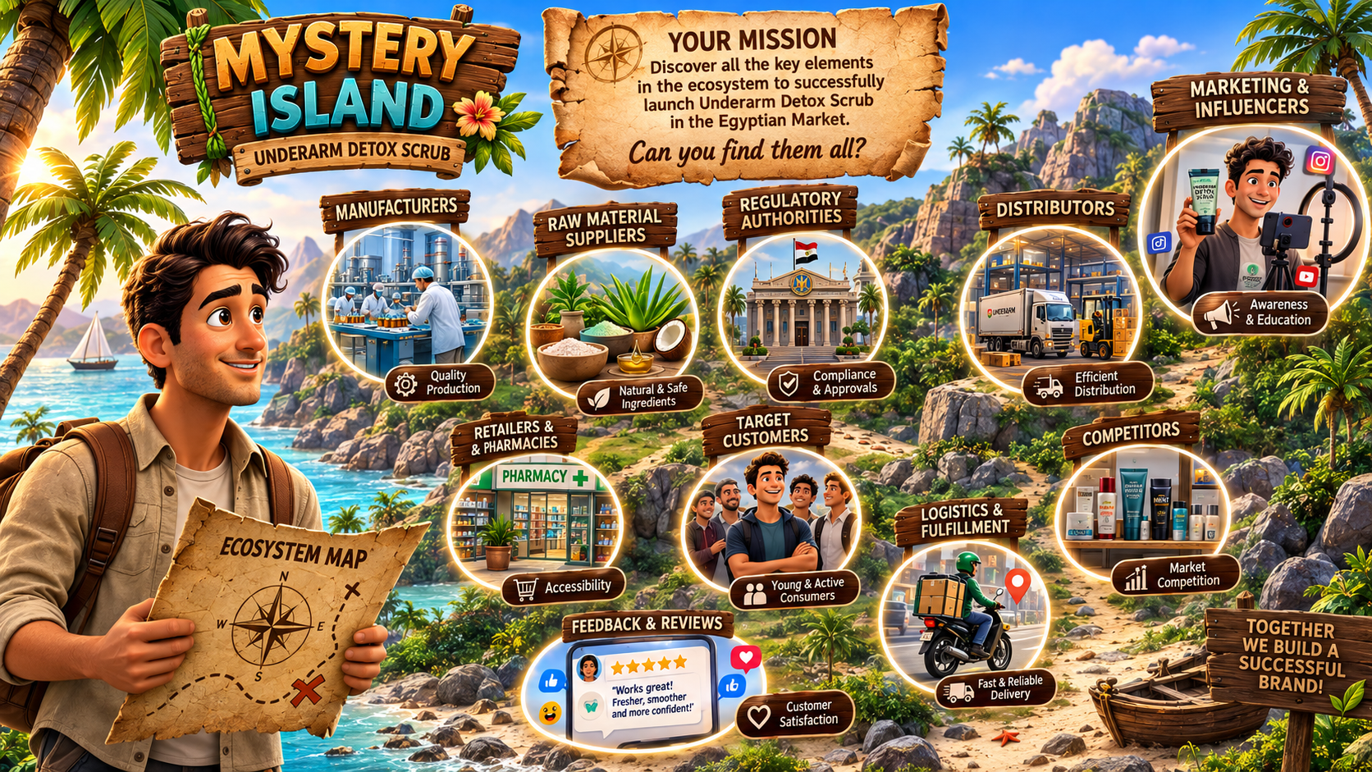

Slide 22
The Industry Life Cycle
Every industry evolves through four stages — sales rise, peak, and eventually fall over time.
Sales / Revenue
Time
Introduction
Growth
Maturity
Decline
Product launches. Few rivals, slow sales, high costs, and heavy investment.
Demand takes off. Sales climb fast, new entrants arrive, and profits rise.
The market saturates. Sales peak and flatten; efficiency and competition dominate.
Demand fades. Sales fall as substitutes emerge; firms exit or reinvent.

Slide 23
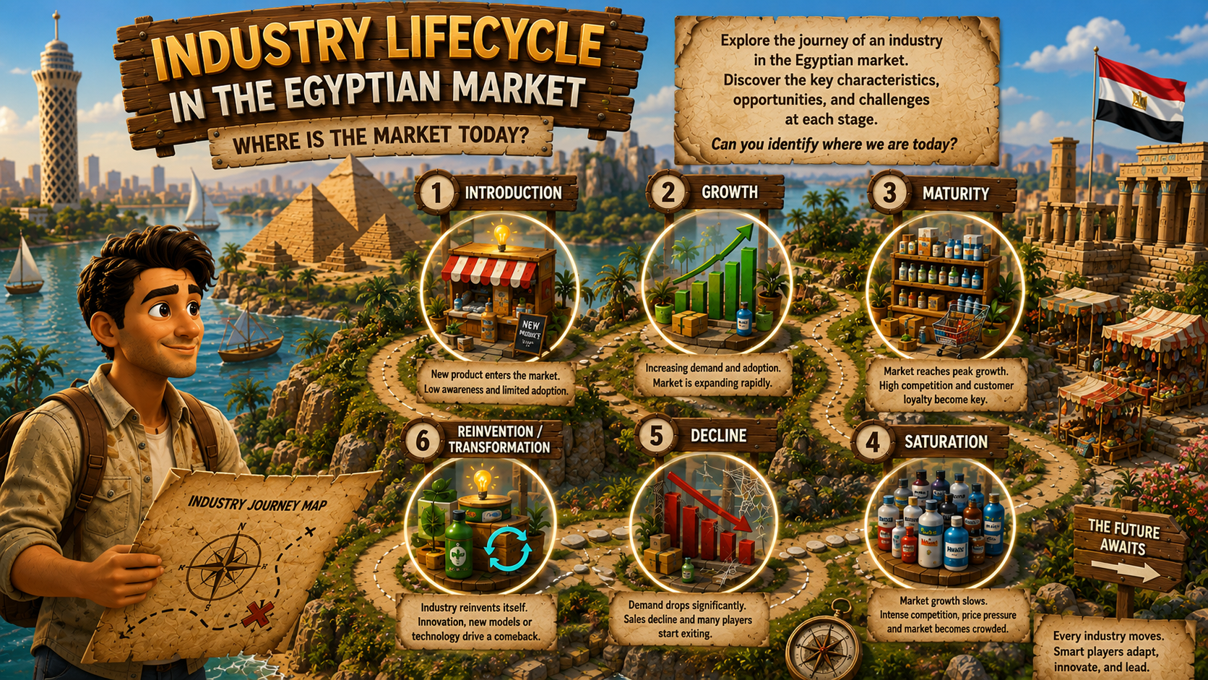

Slide 24
CORE CONTENT · FRAMEWORK 2
4:15 – 5:25 PM
The Business Model Canvas
One page. Nine blocks. The fastest way to pressure-test a business idea before writing a full plan.
Speed
Visibility
A full business plan takes weeks. A BMC takes an afternoon — and exposes the same fatal flaws.
All nine moving parts of the business sit on one page, so contradictions are impossible to hide.
Iteration
Alignment
Cheap to redraw. Version 1 tonight, versions 2–7 as the week sharpens every block with real numbers.
Your BD Squad, your coach, and the CEO all argue from the same single page — not 40 slides.
Origin note: developed by Alexander Osterwalder, the BMC is the global standard for sketching how any organization creates, delivers, and captures value. You will live inside it all week.
HANNA COSMECEUTICALS · BD SIMULATION · DAY 1
10

Slide 25
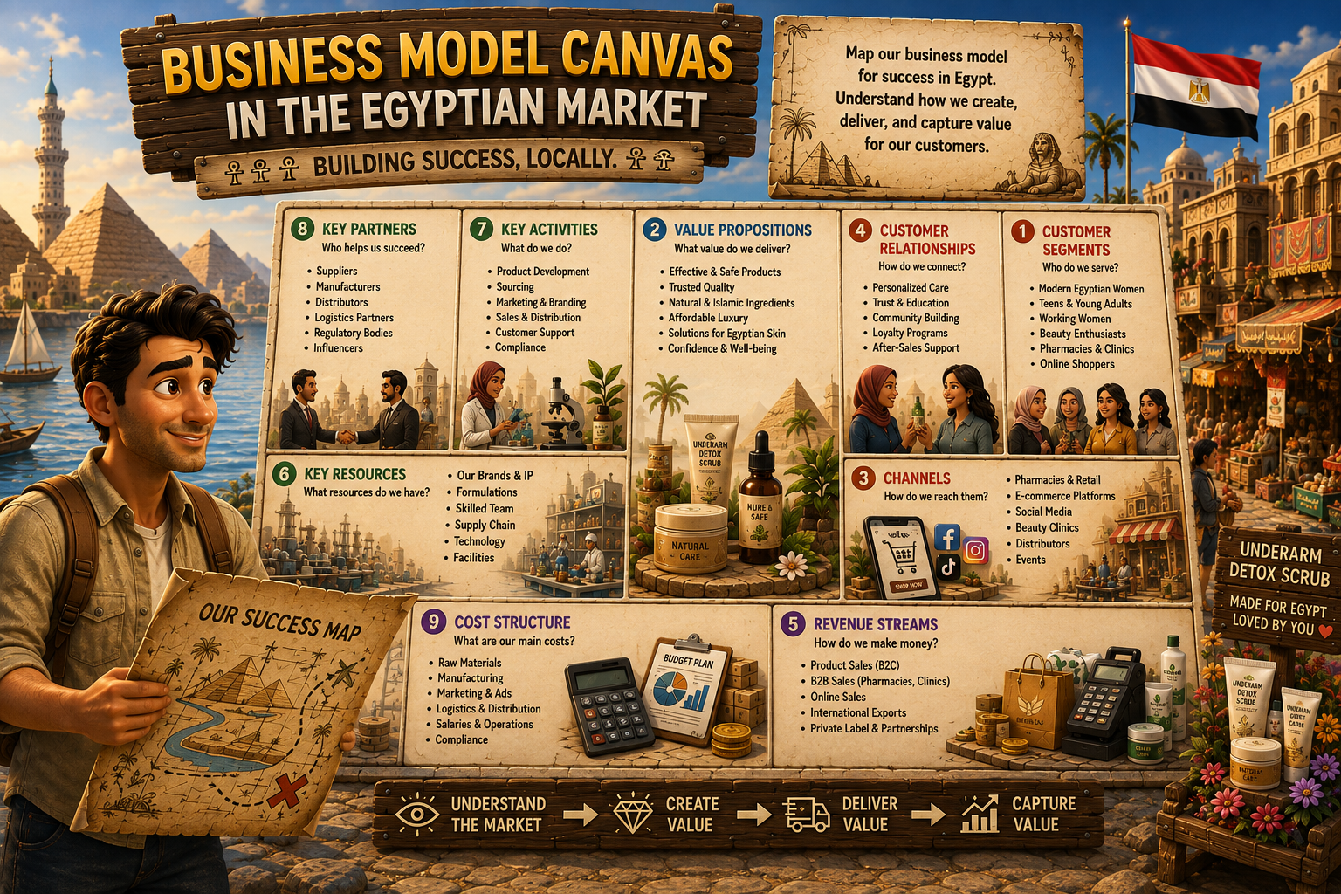

Slide 26
CORE CONTENT · FRAMEWORK 2
The Nine Blocks — Hanna's Canvas
Key Partners
Key Activities
Value Propositions
Customer Relationships
Customer Segments
Manufacturers, distributors, retail partners — who helps us deliver?
Formulation, sourcing, sales, marketing
What unique value do our products deliver — and to whom?
How we acquire, retain & grow customers
Who are we creating value for in Egypt?
Key Resources
Channels
Brand, formulas, capital, team
Retail, e-commerce, pharmacy
Cost Structure
Revenue Streams
Fixed & variable costs to build and run this business
How — and from whom — does Hanna earn money?
Tonight you fill all nine — for the Egypt private-label launch and the regional HQ — using the scenario brief plus clearly stated assumptions.
HANNA COSMECEUTICALS · BD SIMULATION · DAY 1
11

Slide 27
BUILD TIME
5:45 – 6:45 PM
Applied Workshop — BMC Version 1
Your task: in BD Squads, draft Version 1 of Hanna's Business Model Canvas for the Egypt private-label launch and regional HQ.
Where strong squads start
Customer Segments first — 'everyone in Egypt' is not a segment.
Then Value Propositions — why Hanna's three products, and why natural & skin-first wins here.
Let Channels and Key Partners follow from where your segment actually shops.
Sanity-check Cost Structure vs Revenue Streams against the USD 10M reality.
Ground rules
Fill all 9 blocks — a blank block is a decision you haven't made yet.
Use only the scenario brief plus reasonable, clearly stated assumptions.
No agency-deal thinking — leadership wants owned brand equity and an owned regional base.
State assumptions explicitly rather than hunting for one 'correct' number.
Keep it to one page — the discipline is the point.
HANNA COSMECEUTICALS · BD SIMULATION · DAY 1
12

Slide 28

RESEARCH & STRESS-TEST
6:45 – 7:35 PM
AI Co-Pilot Lab
Use AI the way a working BD manager does — research assistant, first-draft generator, sounding board. Never an unreviewed source of truth.
STEP 1 · RESEARCH
STEP 2 · STRESS-TEST
STEP 3 · REVISE
ChatGPT / Gemini
Claude
Your judgment
Scan the Egyptian cosmeceutical ecosystem: major competitors, typical retail & e-commerce channels, rough regulatory steps — plus a snapshot of the wider North Africa landscape.
Feed your research in and ask Claude to critique your BMC draft: gaps, contradictions, unrealistic assumptions. Argue back where you disagree.
Update the canvas. Note what you kept, what you changed, and why — coaches score judgment quality, not AI volume.
The AI Co-Pilot Rule: every deliverable must show your own judgment on top of the AI output — what you kept, what you changed, and why.
HANNA COSMECEUTICALS · BD SIMULATION · DAY 1
13

Slide 29
SUBMISSION & DEBRIEF
7:35 – 8:00 PM
Tonight's Deliverable: BMC v1
Draft Business Model Canvas — Version 1
HOW YOU'RE SCORED (WEEK-WIDE)
One page · all 9 blocks completed · assumptions stated
30%
Framework application
20%
Commercial numbers
Before you submit, check:
Every block is filled — no placeholders, no blanks.
The canvas covers all three workstreams: private label, Egypt entry, regional HQ.
Assumptions are labeled as assumptions.
Revenue and cost blocks don't contradict each other — or the USD 10M reality.
You can defend any block in 30 seconds if the coach points at it.
15%
Use of AI tools
15%
Communication & negotiation
10%
Final business plan quality
10%
Final pitch
HANNA COSMECEUTICALS · BD SIMULATION · DAY 1
14

Slide 30

END OF DAY 1
You sketched the shape.
Tomorrow, prove the market.
DAY 2 · MARKET RESEARCH FUNDAMENTALS & SIZING THE OPPORTUNITY
TAM · SAM · SOM · CAGR · STP — a defensible number for the Egyptian market, and a real answer to “who exactly are we selling to?”
Bring tonight's BMC v1 with you — Day 2 starts by attacking it with data.
HANNA COSMECEUTICALS · BD SIMULATION · DAY 1
15

Slide 31
APPENDIX · GLOSSARY
1 of 3
Key Terms — Core Concepts
Business
Business Model
An organisation that creates value customers gladly pay for, solves a real problem in the market, and adapts its model as conditions shift.
How a company creates, delivers and captures value — what it sells, to whom, through which channels, at what cost, and how it makes money.
Business Development
Business Model Canvas (BMC)
The structured, relentless pursuit of sustainable, inclusive and profitable growth — across markets, partnerships and products.
A one-page tool of nine linked blocks used to design and pressure-test a business model in hours rather than weeks.
Value Proposition
Business Ecosystem
The specific benefit a product delivers to a defined customer segment — and the reason that segment chooses it over the alternatives.
The interconnected network of suppliers, manufacturers, distributors, competitors, regulators and customers that co-evolve around a business.
HANNA COSMECEUTICALS · BD SIMULATION · DAY 1
28

Slide 32
APPENDIX · GLOSSARY
2 of 3
Key Terms — Market & Strategy
Market Research
Industry Life Cycle
The systematic gathering and analysis of data on customers, competitors and channels to replace assumption with evidence before a decision.
The four stages every industry passes through — introduction, growth, maturity and decline — each demanding a different strategy.
Go-to-Market (GTM)
Segmentation, Targeting & Positioning (STP)
The plan for reaching customers: which segments to enter, through which channels, at what price, with what message and sales motion.
Split the market into segments, choose which to serve, then define the distinct place the brand will occupy in the customer's mind.
TAM · SAM · SOM
CAGR
Total addressable market, the serviceable slice you can realistically reach, and the share you can obtain in a defined period.
Compound annual growth rate — the smoothed year-on-year growth of a market or revenue line across several periods.
HANNA COSMECEUTICALS · BD SIMULATION · DAY 1
29

Slide 33
APPENDIX · GLOSSARY
3 of 3
Key Terms — Commercial & Financial
Private Label
Agency Agreement
Products made by a third-party manufacturer but formulated, branded and sold as your own — margin and control stay in-house.
A contract appointing a third party to market and distribute a company's products in a defined territory on its behalf.
P&L Statement
Breakeven Point
The profit and loss account — revenue, cost of goods, operating expenses and the resulting profit over a defined period.
The level of sales at which total revenue exactly covers total fixed and variable costs — beyond it, every unit adds profit.
Cosmeceutical
Regional Headquarters
A cosmetic product formulated with active, science-backed ingredients intended to deliver a measurable skin benefit.
A country-level base that manages operations, partners and expansion for a wider region — here, Cairo for North Africa.
HANNA COSMECEUTICALS · BD SIMULATION · DAY 1
30

